Slide 1
Swagger Design Guidance: Object Sharing
NEM DA submission: 17/1/2018
Status: draft
Document version: 0.3
Author: Ruud
Discussed with: Javier, Denis L

Slide 2
Summary of Proposal
Guidance to avoid coarse grained object sharing between operations defined in a Swagger.
Programmes should follow the example set by Open Banking.

Slide 3
Context / Motivation
Historically, the design of WSDL/XSDs for NEM SOAP services involved the creation of coarse grained data objects shared between operations of a service. For example:
Individual_TO
Product_TO
DepositArrangement_TO
This introduced a series of problems (see next slide) without delivering benefits.
Open Banking has developed the first set of Swagger definitions for REST services, avoiding these problems. Everyday Banking is following suit.
Various other programmes will soon be implementing REST services.
Although we have good examples in Open Banking, in the absence of an explicit steer, there is a risk that designers revert back to coarse grained object sharing as this is what they will be used to for SOAP services.

Slide 4
Problem 1: Broad/Loose schema
In order for object definitions to be shareable across multiple operations, their schema are defined excessively broad and loose.
The deck “New NEM Service Design - Past, Present, Future (July 2016)” explains why this is a serious problem.
In summary, excessively broad/loose schema:
Increase the number of integration defects, because they increase the scope for consumers to send invalid messages (even though they are valid according to the schema).
Require additional message validation code to be written.
Expose a security risk by weakening DataPower message validation.
SO did not go live until NEM DC – refactored the request messages exposed via On Ramp.
Make it harder to automatically generate test messages. Most automatically generated test messages will be nonsensical.
Slow down design. This happens in two ways:
Where a schema does not specify a valid message unambiguously, additional design documentation is required to do so. This often involves duplication.
Extra design effort is made to make objects re-usable across purposes.

Slide 5
Example: why “Involved Party” should not be a Swagger object shared between operations
Retrieve (GET) Involved Party
The service response will consist of a large set of information. Most fields need to be optional, as the data will have been populated at any time during a period of years during which the fields may not always have been mandatory.
Update (POST or PUT) Involved Party
You can only provide optional fields that are “updatable” plus customer number.
Create (POST) Involved Party
Unlike Retrieve and Update, there will be mandatory fields. On the other hand, the number of fields to be provided to set up a customer is much lower than those returned in a GET. Many fields are only populated as part of later updates.
Search (GET) Involved Party
The information returned is a summary – a very small subset of a Retrieve.

Slide 6
Problem 2: Change contagion
A change to a shared object affects all operations in the service referring to it.
Often projects need a change to one operation only. With shared objects we would need to change multiple operations affected, increasing project scope.
There is an argument operations cannot change independently of one another anyway, because they share the same swagger. However:
A change limited to one operation inside a swagger requires only an automatic regression test of the unaffected operation with the new swagger. No errors should be expected.
A change to an object shared by multiple operations in a Swagger requires a change to code of otherwise unaffected operations. Subsequent tests are more likely to result in errors. The amount of build and test work is significantly higher due to object sharing.
There is an argument that this problem can be solved through versioning of object definitions. However, this is an extreme measure that introduces many other problems:
Versioning re-usable objects invariably leads to an explosion of major versions because of contagion effects.
Alternatively transformation could be used to contain this, but this would now be significantly more complex too.
Versioning is already complex with service re-use between BPM processes and channel applications, and multiple parallel projects changing the same services.
It would be a high risk approach we have no experience with.

Slide 7
Recommendation: Do not use coarse grained object definitions
When it’s ok to share an object definition between operations:
When the requirements around the object are truly the same between operations.
When the object is unlikely to change.
Examples
Account number
Email address
Phone number
Service header
Error object
When NOT to share an object definition between operations
When different operations impose different data constraints
When the object is expected to undergo some change throughout the lifecycle of a service.
Examples of when NOT to share an object definition:
Involved Party
Arrangement or Account
Product

Slide 8
Implications
It is possible that the definition of shared objects / RDO’s is encouraged by the use of RSA. However this is not enforced. We should use RSA in a way that works for us.
Programmes need to follow the NEM Open Banking Swagger Specs as example.
As a separate but related issue, there is no need for the “_RDO” postfix in object names observed in one design.

Slide 9
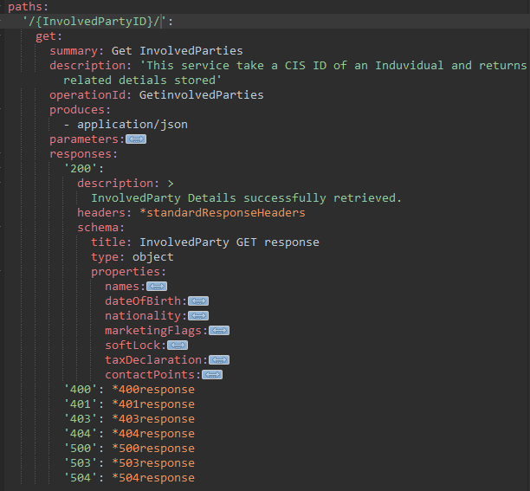
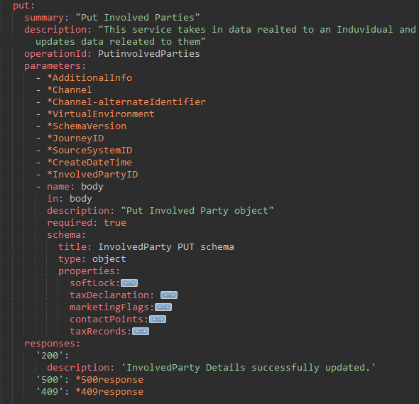
Appendix Example: no coarse grained object sharing in EDB

